Slide 1
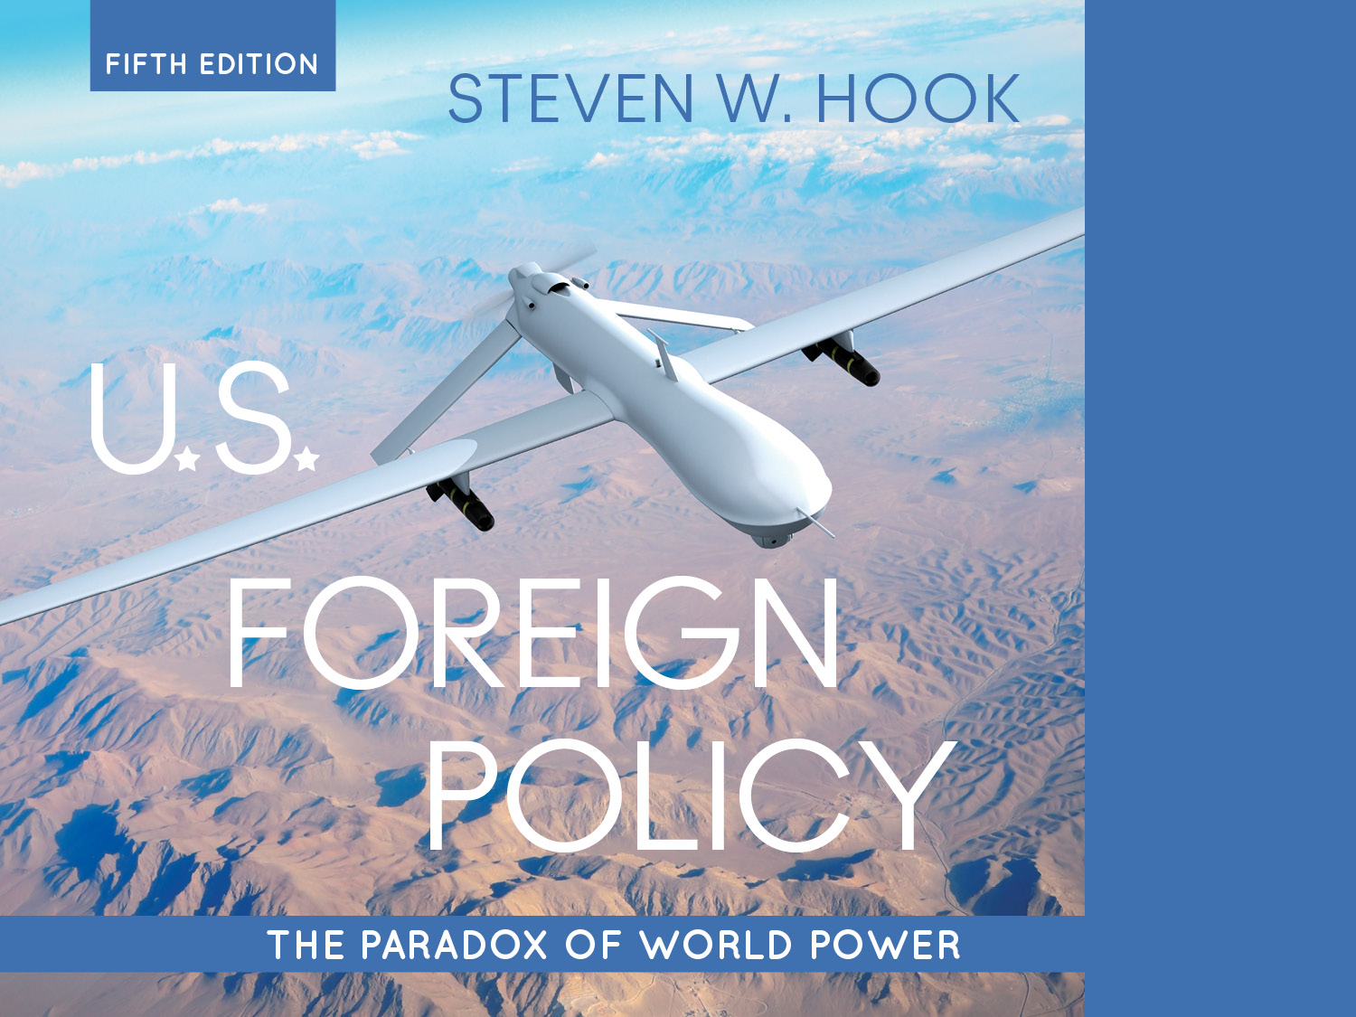
1. The United States in a Turbulent World
U.S. Foreign Policy: The Paradox of World Power| Steven W. Hook| © 2015| SAGE Publications, Inc.

Slide 2
Learning Objectives
After reading this chapter, you should be able to:
Discuss the basic indicators of world power and where the United States stands.
Summarize four categories of challenges facing U.S. world power.
Explain how culture, institutions, and civil society create the paradox of U.S. world power.

Slide 3
Snapshot: U.S. in the World
Unipolarity: Global power structure where one nation exercises unparalleled power
Primacy: Predominant strength in and control of a world system vested in one country
Why is the U.S. not a “hegemon”?
The United States is home to less than 5% of global population but has advantages in:
Scale of its economy and trade relationships
Control of the military realm
Soft power
Notes:
Learning Objective number: 1.1
Ask students for the aspects of US power here.
Ask them what they think soft power is and looks like.

Slide 4
Snapshot: U.S. in the World
U.S. economic might
Largest economy: $17.4 trillion in production of goods and services in 2014, 22% of the global total
Foremost trading state: $1.6 trillion in exports, $710 billion in services overseas, $2.9 trillion in imports
U.S. military might
Highest military spending: $700 billion in 2010 (43% of global total)
Vast technological edge and “command of the commons” (sea, space, and air)
U.S. cultural might
Primacy also derives from soft power (Nye 2004).
Notes:
Learning Objective number: 1.1
Point out the ridiculous military might ration, argument can be made that the economy is a little closer.

Slide 5
Time for pessimism?
Ongoing debate between declinist and optimists.
Declinist argue that U.S. standing has suffered since the beginning of the 21st century.
Unilateralism of the Bush Doctrine (Iraq war, regime change, preemptive war).
2007/8 Global financial crisis
Obama offered a new, more multilateral and cautious foreign policy.
Notes:
Any other problems, see if you get them to think about polarization at home.

Slide 6
The United States in a Turbulent World
The United States faces major challenges to its predominance from seismic shifts in the global security environment.
Escalating terrorism
Revival of great power competition
Threats to American hegemony
Advances in military technology
Strains in the “global commons”
Notes:
Learning Objective number: 1.2
Ask them to brainstorm an example here for each to put it in reference to contemporary events.

Slide 7
Challenges to U.S. Primacy
Four key challenges
Cycles in the balance of power: Difficulties past great powers have faced in preserving advantages
Its own historical experiences: Global animosity generated by past U.S. foreign policy choices
Resistance to globalization: Anti-Americanism due to globalization
Terrorism and asymmetric warfare: Blowback against American dominance and intervention
Notes:
Learning Objective number: 1.2
Are we missing any?

Slide 8
Cycles in the Balance of Power
Is a U.S.-dominated world advantageous for everyone or dangerous?
Advantages: Maintains stability in the international system by discouraging conflict, covering costs of military security, and promoting global economic development
Weaker states ally with dominant state rather than challenge it
The United States promotes “collective goods” while furthering own national interests
Hegemonic-Stability Theory
Notes:
Learning Objective number: 1.2

Slide 9
Cycles in the Balance of Power
Disadvantages: Global projection of power is difficult to maintain
Increasing costs of maintaining order
Decreasing returns for protection, trade, growth
Large trade and budget imbalances
Imperial overstretch: Attempt to control too much territory
Notes:
Learning Objective number: 1.2

Slide 10
Shadow of the Past
Global animosity generated by U.S. foreign policy record
Territorial expansion
Treatment of Native American populations
Importation of slaves from Africa
Frequent intervention in Latin America
Support of dictatorships abroad
Reports of mistreatment overseas and at home during war on terror
Abu Ghraib, 2012 Koran burning
Notes:
Learning Objective number: 1.2
Are there any new developments on this front?

Slide 11
Resistance to Globalization
What is globalization?
Linking of national and regional markets into single world economy
Anti-Americanism due to globalizing markets
Large cash and product flows favor U.S. multinational corporations (MNCs)
Discontents
Growing gap between rich and poor—“rich getting richer” and “poor getting poorer”
Consumerism vs. cultural diversity
Environmental concerns
Human rights issues—“sweatshop” labor
Labor and union political battles
World Trade Organization (WTO) protests in Seattle (1999)
Notes:
Learning Objective number: 1.2
Where is anti-globalization sentiment coming from these days?
The political left or the political right?

Slide 12
Terrorism and Asymmetric Warfare
What is terrorism?
An attempt to gain attention and political consensus through the psychological inducement of mass fear
Elements
Political purposes
Varying motivation (religious, political, and ethnic)
Psychological effects (fear)
Civilian and non-civilian targets
Often unconventional tactics (car bombing, kidnapping, hijacking)
Asymmetric warfare (weak groups against stronger opponents)
Element of surprise and/or secretiveness
September 11 attacks
Certain characteristics fit all of these elements
Notes:
Learning Objective number: 1.2
Probably skip most of this.
Ask students what terrorism is

Slide 13
Terrorism and Asymmetric Warfare
What is terrorism & asymmetric warfare?
An attempt to gain attention and political consensus through the psychological inducement of mass fear
“Weapons of the weak”
Exploitation of vulnerable institutions, public opinion, and material goods
Unconventional tactics (terrorism part of this warfare)
Suicide terrorism (most damaging form of terrorism)
Increased use following World War II
Paradox of fewer attacks but increased destruction and casualties
Notes:
Learning Objective number: 1.2

Slide 14
Terrorism and Asymmetric Warfare
Counterterrorism efforts make up an increasingly large part of U.S. foreign policy strategy and doctrine
Requires timely intelligence, smaller military deployments, increased homeland security
Four major challenges
World primacy makes the United States the target of resentment
Difficult for the United States to shift away from conventional warfare to asymmetric warfare due to historical experiences
U.S. population unaccustomed to long-term conflict
The enemy is “an invisible foe,” often impossible to engage through diplomacy
Notes:
Learning Objective number: 1.2

Slide 15
The Paradox of America’s World Power
What is the main paradox?
The same factors that helped promote the growth of U.S. power now also threaten its effective use.
What is the key question?
With domestic and international challenges, can the United States retain its primacy and power in a unipolar system?
Why is this a challenge?
Tensions between institutional braches, state actors, non-state actors, international actors, and the international system often render foreign policy making incremental, conflicting, and inefficient.
Notes:
Learning Objective number: 1.3

Slide 16
The Paradox of America’s World Power
Paradox visible in recent examples
Contradictions in post–Cold War grand foreign policy strategy under Clinton
In 1999, Congress sued Clinton over military intervention in Kosovo
The Bush administration’s failure to act on intelligence regarding threat from bin Laden prior to 9/11
Wikileaks, Edward Snowden
Impacts of social media
Notes:
Learning Objective number: 1.3

Slide 17
Three Aspects of the Paradox
All are strengths, yet all create vulnerabilities
National exceptionalism: Unique cultural roots of the United States
Conflicts among and diffusion of domestic institutions and faith in open markets
Many civil (non-state) actors involved in the policy process
Notes:
Learning Objective number: 1.3

Slide 18
Cultural Roots of the Paradox
National style unique to each country
Cultural and historic influences affect U.S. approach to viewing the world
Geographical independence and separation
Independence (political and economic) from outside actors
Fewer class divisions than European powers of the time
National exceptionalism
Moral, ethical, political superiority to other nations
Moralism and self-interests rooted in policy decisions
Good vs. evil dichotomy
Isolationist vs interventionist
Impulsive vs prudent public
Notes:
Learning Objective number: 1.3

Slide 19
Institutional Branches
Branches: Political institutions that govern and constrict behavior of actors
Congress (members, committees, chambers)
Presidency (staff, offices, agencies)
Courts (political vs. legal issues)
Also political agencies and governing rules that act as institutions
Cabinet departments (e.g., Defense and State)
Federal agencies (e.g., USAID and USTR)
Notes:
Learning Objective number: 1.3

Slide 20
Institutional Branches
Diffusion of power
Political liberties
Separation of powers
Checks and balances
“Invitation to struggle” within branches and agencies for foreign policy making
No clear lead agency
Competition and vagueness of power and sovereignty in decision-making
Deference often given to president, leading to danger of an imperial presidency
President granted broader authority
Improved interbranch relationships
Notes:
Learning Objective number: 1.3

Slide 21
Pervasive Civil Society
Forces outside government or “transnational civil society”
Public opinion, media, interest groups, and intergovernmental organizations
Openness in political system for transnational groups
Transnational society similar to U.S. civil society
Pluralist society or competition of groups (in theory or setup)
“Weak” state and unequal access (more current description)
Increasing relevance and power of IGOs and NGOs
Economic institutions that regulate trade, aid, and commerce (e.g., WTO, OECD, World Bank, IMF)
Security/military institutions (e.g., NATO, UN)
Multinational corporations (e.g., political party and campaign donations, global reach of firms)
Notes:
Learning Objective number: 1.3

Slide 22
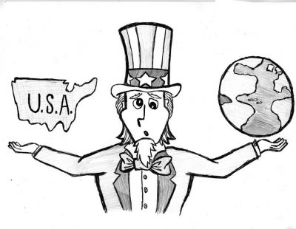
Thinking ahead:
U.S. Primacy
Yes/No?
Good/Bad?
The 3 Pillars of the Paradox
The 4 Challenges

Slide 23
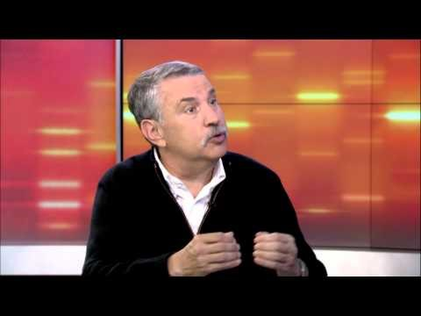
American (Un)exceptionalism?

Slide 24
Conclusion
The paradox restated
Can the United States balance power, openness, and international leadership with its rising domestic and global constraints?
U.S. foreign policy varies
Conflicting, incremental, unilateral, multilateral, moralistic, and nationalistic, leading to image as a curious and unpredictable world power
Often pursuing a “lead by example” and activist foreign policy at once
Chaotic
Reactive

